Slide 1
Selenium
Automated Testing Tool
Prsented By - Bhabani

Slide 2
History
Developed in 2004 by Jason Huggins as a JavaScript library used to automate his manual testing routines
Selenium Core is born whose functionality underlies the Selenium RC (Remote Control) and Selenium IDE tools
The Limitation of having a JavaScript based automation engine and browser security restricted Selenium to specific functionality
Google, who has been a long time user of Selenium, had a developer named Simon Stewart who developed WebDriver. This tool circumvented Selenium’s JavaScript sandbox to allow it to communicate with the Browser and Operating System directly using native methods
In 2008, Selenium and WebDriver merged technologies and intellectual intelligence to provide the best possible test automation framework

Slide 3
Introduction
Selenium is a suite of testing automation tools used for Web-Base applications: Selenium IDE, Selenium RC, Selenium WebDriver and Selenium Grid
These tools provide a rich set of testing functions specifically geared to varied testing scenarios of all types of Web applications
The operations provided by these tools are highly flexible and afford many options for comparing UI elements to expected application behavior
Selenium tests can be executed on multiple browser platforms

Slide 4
Why Use/Learn Selenium
Increases you marketability
Has a lot of Java planks
Growing Industry standard
Assist with the deployment of defective-free code
Open source, web-based testing automation tool and cross-browser compliant
Muti-language backend support (Java, Ruby, Python, C#, PHP, ect…)

Slide 5
Selenium Tools
Selenium IDE
Rapid prototyping tool for building test scripts
Firefox plugin
Can be used by developers with little to no programming experience to write simple tests quickly and gain familiarity with the Selenese commands
Has a recording feature that records a user’s live actions that can be exported in one of many programming languages
Does not provide iteration or conditional statements for test scripts
Can only run tests against FireFox
Developed tests can be run against other browsers, using a simple command-line interface that invokes the Selenium RC server
Can export WebDriver or Remote Control scripts (these scripts should be in PageObject structure)
Allows you the option to select a language for saving and displaying test cases

Slide 6
Selenium Tools
Selenium RC Selenium 1
It ‘inject’ JavaScript functions into the browser when the browser is loaded and then uses its JavaScript to drive the AUT within the browser
Mainly supported in maintenance mode
Provides support for several programming languages
Selenium WebDriver
Designed to provide a simpler, more concise programming interface in addition to addressing some limitations in the Selenium-RC API
Developed to better support dynamic web pages where elements of a page may change without the page itself being reloaded
Makes direct calls to the browser using each browser’s native support for automation.
Has the Selenium 1 (aka Selenium RC) underlying technology for flexibility and Portability
Migrating From Selenium RC to Selenium WebDriver
Not tied to any particular test framework, so it can be used equally well in unit testing or from a plain old “main” method.

Slide 7
Selenium Tools
Selenium Grid
Scales the Selenium RC solution for large test suites and test that must be run in multiple environments
Tests can be run in parallel with simultaneous execution (different tests on different remote machines)
It allows for running your tests in a distributed test execution environment
Used to run your tests against multiple browsers, multiple versions of browser, and browsers running on different operating systems
It reduces the time it takes for the test suite to complete a test pass

Slide 8
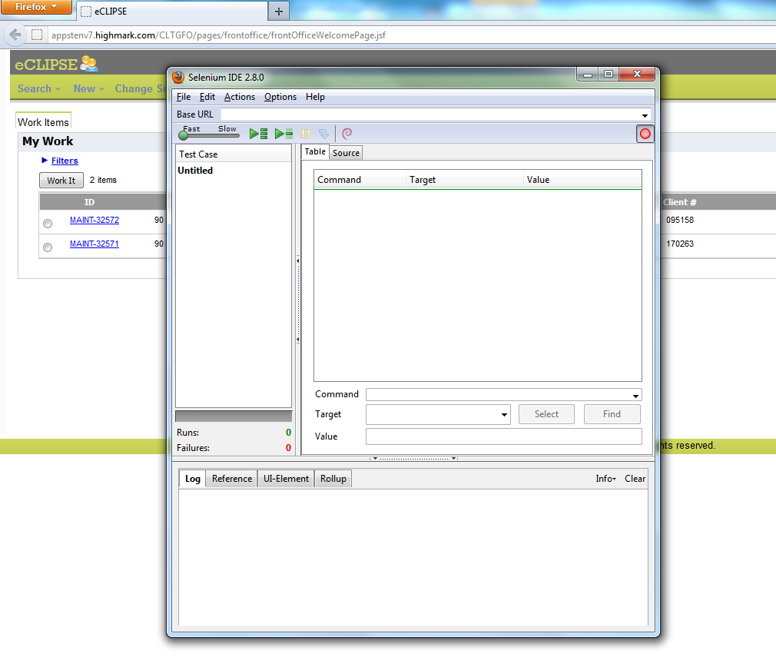
Selenium IDE

Slide 9
Selenium IDE
Selenese Commands
Action
Manipulate the state of the application
Used with “AndWait” (clickAndWait)
Accessors
Examines the application state and stores the results in variables
Used to auto generate Assertions
Assertions
Similar to Accessors but verifies the state of the application to what is expected
Modes: assert, verify and waitFor

Slide 10
Selenium IDE
Syntax
Has two parameters (both are not required)
Can view command requirements from the command reference tab
Parameters
Locators identify a UI Element on a page
Test Patterns are used for asserting or verifying
Selenium variable or Text Patterns that can be entered in input fields or drop down selections

Slide 11
Selenium IDE
Locators
By Identifier
Used by default
Locator type is “identifier”
First element with id attribute value matching the location will be used
First element with a name attribute matching the location will be used if there are no id matches
By ID
More limited than the “identifier” type
Locator type is “id”
Use this type when you know the element’s id
By Name
Locates an element with a matching name attribute
Filters can be applied for elements with the same name attribute
Locator type is “name”

Slide 12
Selenium IDE
Matching Patterns
Text Patterns
A parameter required by following Selenese commands: verifyText, verifyText, verifyTitle, verifyAlert, assertConfirmation, verifyPrompt, ect…
Globbing Patterns
Pattern matching based on wild card characters (*, [], -)
Uses the “glob:” label
Default pattern matching scheme
Regular Expressions
The most powerful pattern matching scheme
Prefixed with “regexp:” label
Exact Patterns
Uses no special characters, no need to escape characters
Prefixed with “exact:” label

Slide 13
Selenium WebDriver
Project Setup
Java
The easiest way is use Maven and Gradle. Maven will download the java bindings (the Selenium 2.0 java client library) and all its dependencies, and will create the project for you, using a maven pom.xml (project configuration) file
You can then import the maven project into your preferred IDE, IntelliJ IDEA or Eclipse.
From a command-line, CD into the project directory and run maven as follows: mvn clean install

Slide 14
Selenium WebDriver
Commands and Operations
To fetch a page you would use the “get” command
driver.get("http://www.google.com");
Locating UI Elements
Language bindings expose a “findElement” and “Find Elements” method
The “Find” methods take a locator or query object called “By”
WebElement element= driver.findElement(By.id("coolestWidgetEvah"));
List<WebElement>cheeses = driver.findElements(By.className("cheese"));
WebElement frame = driver.findElement(By.tagName("iframe"));
WebElement cheese = driver.findElement(By.name("cheese"));
WebElement cheese = driver.findElement(By.linkText("cheese"));
WebElement cheese = driver.findElement(By.partialLinkText("cheese"));
Web Element cheese = driver.findElement(By.cssSelector(“#food.span.dairy.aged”)) List<WebElement> inputs = driver.findElements(By.xpath("//input"));
WebElement element = (WebElement) ((JavascriptExecutor)driver).executeScript("return $('.cheese')[0]");

Slide 15
Input and Navigation
Select select = new Select(driver.findElement(By.tagName("select"))); select.deselectAll(); select.selectByVisibleText("Edam");
driver.findElement(By.id("submit")).click();
driver.switchTo().window("windowName");
for (String handle : driver.getWindowHandles()) { driver.switchTo().window(handle); }
driver.switchTo().frame("frameName");
Alert alert = driver.switchTo().alert();
driver.navigate().to("http://www.example.com");
driver.navigate().forward(); driver.navigate().back();

Slide 16
Selenium WebDriver
Page Objects
OO Library that separates test code into a MVC pattern bringing OOP to test scripts
Language neutral pattern for representing a complete page or position of a page in an OO manner
Requires Language specific coding
Used for maintenance, script cascading, enhanced script readability/functionality

Slide 17
Selenium WebDriver
Scripts and Page Objects
Scripts are more procedural while Page Objects are detail oriented
Locators appear once in all Page Objects of a page and do not cross Page Object boundaries
Uses Elements, Actions and Synchronization
Order of Operation
Locator
Element Implementation
Add Elements to Page Objects
Actions

Slide 18
Selenium WebDriver
Do not create the Page Object all at once, build test incrementally
Scripts Should
Not contain any synchronization code
Not contain any Driver API calls (promotes changes to Selenium or other technology without changing the scripts)
Has asserts (determination of results)

Slide 19
Selenium WebDriver
System.setProperty("webdriver.gecko.driver", "Local Driver Path"); driver= new FirefoxDriver();
Driver Implementations
HtmlUnitDriver
The fastest and most lightweight implementation of WebDriver
HtmlUnit is a java based implementation of a WebBrowser without a GUI
For any language binding (other than java) the Selenium Server is required to use this driver
A pure Java solution and so it is platform independent
Supports JavaScript but emulates other browsers’ JavaScript behaviour
FireFox Driver
Controls the Firefox browser using a Firefox plugin
Runs in a real browser and supports JavaScript
Faster than the Internet Explorer Driver but slower than HtmlUnitDriver

Slide 20
Selenium WebDriver
Internet Explorer Driver
This driver is controlled by a .dll files and is thus only available on Windows OS
Each Selenium release has its core functionality tested against versions 6, 7 and 8 on XP, and 9 on Windows7
Runs in a real browser and supports JavaScript
XPath is not natively supported in most versions
CSS is not natively supported in versions 6 and 7
CSS selectors in IE 8 and 9 are native, but those browsers don’t fully support CSS3

Slide 21
Selenium WebDriver
Driver Implementation
Chrome Driver
Chrome Driver is maintained / supported by the Chromium Project
WebDriver works with Chrome through the chromedriver binary (found on the chromium project’s download page)
Runs in a real browser and supports JavaScript
Because Chrome is a Webkit-based browser, the Chrome Driver may allow you to verify that your site works in Safari. Note that since Chrome uses its own V8 JavaScript engine rather than Safari’s Nitro engine, JavaScript execution may differ
Slower than the HtmlUnit Driver

Slide 22
Selenium WebDriver
Opera Driver
See the Opera Driver wiki article in the Selenium Wiki for information on using the Opera Driver
iOS Driver
See either the ios-driver or appium projects
Android Driver
See the Selendroid project

Slide 23
Test NG
TestNG is a powerful testing framework and is inspired from JUnit and NUnit.
It has lots of functionalities than JUnit and NUnit.
Also, it's more powerful and easier to use.
In TestNG, the NG stands for Next Generation.

Slide 24
Features of Test NG
Features of TestNG
TestNG comes with lots of features that make the work easier.
It is open source.
It has a Inbuilt Reporting feature.
It has a flexible test configuration.
Annotations help to organize the test, which also helps to understand easily.
Grouping test cases can be done easily.
It supports data driven testing feature.
Data Parameterization and Parallel testing are possible.
It supports a variety of tools like Eclipse, IDEA, Maven, etc.
It also helps to Generate logs.

Slide 25
TestNG Annotations
Annotations in TestNG
@BeforeSuite - The annotated method will run before all tests in this suite have run.
@AfterSuite - The annotated method will run after all tests in this suite have run.
@BeforeTest - The annotated method will run before any test method belonging to the classes inside the <test> tag is run.
@AfterTest - The annotated method will run after all the test methods belonging to the classes inside the <test> tag have run.

Slide 26
Test NG ANNOTATIONS continued
Annotations in TestNG
@BeforeClass - The annotated method will run before the first test method in the current class is invoked.
@AfterClass - The annotated method will run after all the test methods in the current class have been run.
@BeforeMethod - The annotated method will run before each test method.
@AfterMethod - The annotated method will run after each test method.

Slide 27
Annotations in TestNG
@BeforeGroups - The set of groups that the configuration method will run prior to. And this method is assured to run shortly prior to the first test method, which belongs to any of these groups is invoked.
@AfterGroups - The set of groups that the configuration method will run after. And this method is confirmed to run shortly after the last test method, which belongs to any of these groups is invoked.
@Listeners - Defines listeners on a test class.

Slide 28
Annotations in TestNG
@DataProvider - Marks a method of providing data for a test method. Now this annotated method has to return an Object[][] where each Object[] can be allocated the parameter list of the test method. The @Test method that requires to get data from this Data Provider needs to use a data Provider name equivalent to the name of this annotation.
@Factory - Marks a method as a factory that returns objects that will be used by TestNG as Test classes. The method must return Object[].
@Parameters - Describes how to pass parameters to a @Test method.
@Test - Marks a class or a method as part of the test.

Slide 29
Sample script
Launch Browser
We will use the following code.
// Launching Google from Firefox with the help of "gecko driver." System.setProperty("webdriver.gecko.driver", "Need to get Gecko driver Path" );
WebDriver driver = new FirefoxDriver();
driver.get("https://google.com");
// We are getting the page title and printing it in a console to verify that we are in the right page.
System.out.println("Page Title : " + driver.getTitle());

Slide 30
EleMENT LOCATORS
Types of XPath
Element Locators help to find the element on the web pages accurately. Let’s start with Syntax XPath. It can be written in two types as below.
Xpath=//tagname[@attribute='value’]
//: Select current node.
Tagname: Tagname of the particular node.(Input)
@: Select attribute.
Attribute: Attribute name of the node. ( id, value, name, type, src, and alt )
Value: Value of the attribute. (login_id, text_value, username, login_button,/images/btn_signin.gif and SignUp_button.)
Absolute XPath - It will be in long, and you can see HTML DOM Structure which will be followed by single (/).
/html/body/div/selection/div[2]/div/div/input[1]
**Relative XPath– It will be short, and it will start in the middle of the HTML DOM Structure which will be followed by double (//).
//input[@value='Google Search']

Slide 31
Locate Element - XPath Types
We can also identify an element by attribute values such as element id, element name, class name, and HTML tags in XPath expressions.
Examples with Sample Code Snippet:
<div> <label for="username" id="user"><b>Username:</b></label> <input class="name" id="name" type="text"/> <input class="btn btn-large" type="submit" value="OK" /> <a title="FrescoPlay" href="https://apps.fresco.me">Fresco</a> <img src="/selenium.jpeg"/> </div>
xpath=//input[@type='text']
xpath=//label[@id='user']
xpath=//input[@value='OK']
xpath=//*[@class='name']

Slide 32
Locate Element - By ID and By Name
The easiest and the fastest way you can identify the elements is by their (id or name attribute), provided unique values have been assigned to all UI Elements on a web page.
By ID: driver.findElement(By.id("element id"))
By Name: driver.findElement(By.name("element name"))
Example with Sample Code Snippet:
<label for="coursename"><b>Coursename: </label></b> <input name="coursetitle" id="coursename" type="text"/>
WebElement locateByID = driver.findElement(By.id("coursename"));
WebElement locateByName = driver.findElement(By.name("coursetitle"));

Slide 33
Regular Expression in Xpath
XPath - Partial Matching Attribute
We can locate elements using XPath by partial matching attribute values as follows:
starts-with() as in input[starts-with(@id,'email')] retrieves element whose id starts with text email.
ends-with() as in input[ends-with(@id,'email')] retrieves element whose id ends with text email.
contains() as in input[contains(@id,'email')] retrieves element whose id contains text "email".

Slide 34
XPath - Partial Matching Attribute
Example with Sample Code Snippet:
<div class="Sample Test App Code Snippet"> <input class="email" id="userEmailname" type="text"/> </div>
webdriver.findElement(By.xpath("input[starts-with(@id,'user')]"));
webdriver.findElement(By.xpath("input[ends-with(@id,'name)']"));
webdriver.findElement(By.xpath("input[contains(@id,'mail')]"));

Slide 35
Locate Element - By Link
Elements can be located using the text displayed in the link URL. And It is possible to identify the link element in two type.
Link text – We need to pull the name of the link tag.
Partial Link text- We need to pull the partial name of the link tag.
By.linkText: driver.findElement(By.linkText("link text"))
By.PartialLinkText: driver.findElement(By.PartialLinkText("link text"))
Example with Sample Code Snippet:
<a href="https://www.google.com">Google_HomePage</a>
WebElement findByFullText = driver.findElement(By.linkText("Google_HomePage"));
WebElement findByPartialText = driver.findElement(By.PartialLinkText("Google"));

Slide 36
CSS
Locate Element - By CSS Selectors
CSS Selectors help to identify the elements. And it's comparatively faster in locating elements on a webpage than XPath especially in IE browsers. CSS is considered to be the next best option to locate elements if unique id or name is not available.
TagName : Tagname of the particular node.(Input)
# : Hash sign is used to symbolize ID attribute. It is mandatory to use the hash sign for ID attribute in CSS Selectors.
CSS = <TagName> # <value of ID Attribute> <[AttributeName = Value of attribute]>
. : The dot sign is used to symbolize Class attribute. It is mandatory to use dot sign for the Class attribute in CSS Selectors.
CSS = <TagName> . <value of Class Attribute> <[AttributeName = Value of attribute]>

Slide 37
XPATH and CSS difference
Locate Element - By CSS Selectors
CSS = <TagName> <. or #> <value of Class or ID Attribute> <[AttributeName = Value of attribute]>
Attribute Name : Attribute name of the node. ( id, value, name, type, src, and alt )
Attribute Value : Value of the attribute. (login_id, text_value, username, login_button and SignUp_button.)
Note: We will not use (/,//,@) in CSS Selectors. As / will be replaced as > and // will be replaced as whitespace

Slide 38
Locate Elements - In CSS Selectors
CSS ID – Here we need to replace (ID with #).
<input id="User" name="admin" class="required" type="submit">
WebElement CheckElements =driver.findElements(By.cssSelector("#User"));
CSS Attribute – Here we need to pull <html tag><attribute><value>.
<input id="User" name="admin" class="required" type="submit">
WebElement CheckElements =driver.findElements(By.cssSelector("input[type='submit']"));

Slide 39
Regular Expression in CSS
Locate Elements - In CSS Selectors
We can also locate elements using CSS Selectors by performing partial matching on attribute values as follows:
Match a prefix – ^ as in input[id^='email'] retrieves element whose id begins with text email.
Match a suffix – $ as in input[id$='email'] retrieves element whose id ends with text email.
Match a sub string - * as in input[id*='email'] retrieves element whose id contains text "email".
<input class="email" id="userEmailname" type="text"/>
webdriver.findElement(By.cssSelector("input[id^='use']"));
webdriver.findElement(By.cssSelector("input[id$='name']"));
webdriver.findElement(By.cssSelector("input[id*='mail']"));

Slide 40
Selenium Commands
Selenium Commands
Let’s look into the frequently used commands in the scripting.
Get - It helps to load the URL in a new window in current folder Example: driver.get(“https://google.com”);
Get Title – It helps to get the current page title, and the output should be stored as a string (object/variable). Example: driver.getTitle(“Homepage”);
Get Current URL – It helps to get the current page URL, and the output value should be stored as a string (object/variable). Example: driver.getCurrentUrl (“https://google.com”);

Slide 41
Selenium Commands Cont….
Sendkeys – It helps to give input in a text field (text box). Example: driver.findElement(By.id(“username”)).sendKeys(“user001”);
Click – It helps to click an element like “Submit Button”. Example: driver.findElement(By.id(“Submit”)).Click();
Close – It helps to close the current window which is opened by the webdriver Example: driver.close();
Quit - It helps to close all the windows which are opened by the webdriver Example: driver.quit();

Slide 42
Types of Waits
Types of Wait
All the actions will not happen as expected. Sometimes we need to wait for the application to load as there may be a little delay. Hence, "Wait command is important" to sync the script execution and application behavior.
Now, let's look into types of the wait.
Thread.Sleep
Fluent wait
Implicit wait
Explicit wait

Slide 43
Parameterization in TEXT NG
Parameterization
Let's create a parameterization for cross browser testing as it will be helpful with upcoming hands-on. So now let's create a "CrossBrowserSuite.xml" file. Then we can write our parameter as below in sample.
<?xml version="1.0" encoding="UTF-8"?> <!DOCTYPE suite SYSTEM "http://testng.org/testng-1.0.dtd" >
<suite name="Cross Broswer" parallel="tests">
<test name="firefox test">
<parameter name="browser" value="firefox"/>
<classes> <class name="crossBrowsers.googleLaunch"/>
</classes> </test> <test name="chrome test">
<parameter name="browser" value="chrome"/>
<classes> <class name="crossBrowsers.googleLaunch"/>
</classes> </test> </suite>

Slide 44
Assertion in selenium
Asserts
Asserts help to verify the conditions of a test, and decide whether a test has failed or passed. Refer to the following examples:
Assert.assertTrue("true/false", "We can write our comments"); Assert.assertEquals("Actual Word", "Expected Word"); Assert.assertNotEquals("Actual Word", "Expected Word");

Slide 45
Building a FRameWORK
Building a Framework
The following are required to build a basic framework:
Creating Maven Project
Creating Base and Utility Functions
Organizing Page Objects
Adding Tests
Data-driven / Parameterization Tests
Converting to TestNG Framework
TestNG Listeners
Test Failure Screenshots
TestNG HTML Reports

Slide 46
Selenium WebDriver
Example Java Implementation
LoginPage.java
HomePage.java
LoginTest.java

Slide 47
Selenium Grid
A Grid consists of a single Hub, and one or more Nodes. Both are started using a selenium-server.jar executable.
The Hub receives a test to be executed along with information on which browser and ‘platform’ (i.e. WINDOWS, LINUX, etc) where the test should be run.
Since the Hub knows the configuration for each registered Node, it selects an available Node that has the requested browser-platform combination
Selenium commands initiated by the test are sent to the Hub, which passes them to the Node assigned to that test
The Node runs the browser, and executes the Selenium commands within that browser against the application under test

